Slide 1

Ultrasonic Information Transfer
Application for Information Transfer Using Ultrasound Waves
Presented by: Yoni Grinberg 307868257 & Bar Harush 205713308
Supervisor: Dr. Elena Ravve
Team Code: 26-1-D-7

Slide 2


What We Are Going To Do:
Ultrasonic Data Transfer
Cross-Platform Network
Our project uses ultrasonic waves for data transfer, leveraging their ability to propagate through liquids and be contained by solid barriers.
A many-to-many ultrasonic data transfer network for Android and IOS, with advanced collision avoidance.

Slide 3
Why Ultrasound:
RF Challenges
Ultrasound Advantages
Crowded frequency spectrums.
Propagates well through liquids and tissue.
Susceptible to electromagnetic interference.
Naturally contained by solid barriers, enhancing security.
Signal congestion and "snooping" risks.
Avoids crowded radio spectrums.
Poor propagation through conductive media (examples: water, human body).
Ideal for environments where RF fails (examples: operating rooms, underwater).

Slide 4
Why Is The Project Not Trivial?
From PoC to Network Layer: Transitioning from a basic one-to-one physical link to a robust, scalable many-to-many communication protocol.
Cross-Platform Interoperability: Achieving seamless data exchange between heterogeneous mobile operating systems (Android vs. IOS) with unique audio chipsets and hardware constraints.
Physical and Algorithmic Constraints: Managing severe acoustic challenges like Multipath Propagation (echoes) and Self-Interference on non-real-time mobile hardware.

Slide 5
Project Objectives:
Bridging the Gap
From basic acoustic links to a robust, scalable, and secure network layer.
Secure Multi-User Network
Establish a secure, multi-user ultrasonic network for non-RF applications.
Advanced Arbitration
Implement CSMA/CA for sophisticated channel arbitration.
Cross-Platform Compatibility
Ensure seamless operation between Android and IOS devices.

Slide 6
Algorithmic Challenges And Solutions:
Mitigating Acoustic Interference and Noise
Challenge: Indoor environments suffer from severe Multipath Propagation, where sound echoes overlap and cause Inter-Symbol Interference (ISI).
Solution: Implementing a conservative 0.5ms bit duration to allow signal echoes to decay and utilizing Frequency-Shift Keying (FSK) for robust signal modulation.
Decentralized Channel Arbitration
Challenge: Managing many-to-many communication without a central server or global clock.
Solution: Developing a CSMA/CA-based protocol using unique, prime-number-based backoff timers to minimize collision probability.

Slide 7
Algorithmic Challenges And Solutions: (cnt.)
Overcoming the Hidden Node Problem
Challenge: Undetectable collisions occurring when two transmitters, out of range of each other, simultaneously signal a central receiver.
Solution: Utilizing a synchronized RTS/CTS (Request to Send / Clear to Send) handshake to logically reserve the medium at the receiver's end.
Ensuring Data Integrity in Noisy Channels
Challenge: Environmental noise can easily flip bits in a bit frame.
Solution: Implementing a robust 8-bit CRC checksum and an ACK/NACK feedback loop to verify and retransmit corrupted packets.

Slide 8
Building on Prior Work:
Our project advances previous research in ultrasonic data transfer.
1
2
Foundational PoC
Physical Layer
Previous teams established a one-to-one ultrasonic communication channel between two Android devices.
Utilized Frequency-Shift Keying (FSK) for acoustic data transfer.
3
4
Frequency Selection
Data Processing
Determined 18-20 kHz as optimal for inaudible mobile communication.
Implemented Fast Fourier Transform (FFT) for decoding binary data.

Slide 9
Hardware Equipment:
Heterogeneous Mobile Nodes (Receivers/Transmitters):
We require at least three concurrent devices to validate the many-to-many network topology and collision avoidance.
Testing must include a variety of models—specifically two Android devices and one iPhone—to account for different audio chipsets and microphone placements.
Cross-Platform Development and Compilation:
An Apple Mac is an essential requirement for utilizing the IOS development environment and compiling code for the iPhone Operating System.
Development relies on standard Android and IOS APIs, specifically AudioTrack/AudioRecord for Android and AVAudioEngine for IOS.

Slide 10
Hardware Equipment: (cnt.)
Testing Environment Tools:
Access to standard physical obstacles (examples: solid barriers and walls) is necessary to verify the signal containment and security properties of ultrasonic waves .
Professional audio analysis software is required to verify that bit durations precisely meet the 0.5ms timing requirement .

Slide 11

Addressing Previous Limitations:
Past Challenges
Lack of Network Protocol: Limited to one-to-one connections, unable to handle multiple devices simultaneously. Collisions occurred with three or more devices.
Single Platform Restriction: Exclusively Android, limiting real-world application with heterogeneous devices (Android and IOS).
Our Improvements
Many-to-Many Communication: Introducing CSMA/CA for sophisticated channel arbitration.
Cross-Platform Compatibility: Ensuring seamless operation between Android and IOS.

Slide 12
Our Approach – Frequency-Shift Keying Algorithm
Protocol Overview & Parameters
Algorithm (pseudo code)
We utilize a multi-layered acoustic communication protocol designed for secure, many-to-many data transfer in non-RF environments.
Function TransmitSignal(bitStream):
track = InitAudioTrack(SAMPLE_RATE) for each bit in bitStream:
if bit == 0
then targetFreq = 18000 HZ
else targetFreq = 20000
end if
Physical Layer: Frequency-Shift Keying (FSK) modulation utilizing high-frequency carrier waves (18–20 kHz) to ensure inaudibility.
Data Link Layer: A decentralized CSMA/CA arbitration mechanism with an RTS/CTS handshake to mitigate the Hidden Node Problem.
buffer = GenerateSineWave(targetFreq, phase) ApplyAmplitudeRamp(buffer)
track.write(buffer) end for track.stop() End Function
Protocol Inputs:
Starting and Separating Character— 8-bit.
UserID/Payload — 40-bit unique sender identifier.
CheckSum — 8-bit.
Protocol Output:
Modulated Waveform — FSK-encoded ultrasonic audio stream.

Slide 13
Implementation: Data Encoding – Frequency-Shift Keying
Our application uses FSK to encode binary data onto ultrasonic sound waves. This digital modulation technique changes the frequency of a carrier signal to transmit information.
Binary FSK (BFSK): Carrier shifts between two discrete frequencies for binary (0s and 1s) information.
Frequency Selection: 18 kHz for '0' and 20 kHz for '1', inaudible to humans.
Bit Duration: Optimal 0.5 milliseconds per bit, allowing for signal stability and receiver sampling.

Slide 14
Our Approach – Carrier Sense Multiple Access/Collision Avoidance
Mechanism: We implement a decentralized, asynchronous "Listen-Before-Talk" principle to manage many-to-many communication without a central server.
Function ExecuteCSMA(payload):
while True:
Collision Avoidance: Utilizing an RTS/CTS (Request to Send / Clear to Send) handshake to logically reserve the acoustic medium and solve the Hidden Node Problem.
wait for RBWP_Timer to expire
if ChannelIsIdle(18-20kHz)
then Transmit(RTS_Frame)
wait for CTS_Frame (Timeout = 2s)
if CTS_Received
then Transmit(Data_Frame)
wait for ACK
return Success
else
wait MBWP (Random Backoff)
end if
else
wait MBWP until idle
end if
end while
End Function
Backoff Strategy: We use unique prime-number-based timers to minimize the probability of simultaneous retransmissions.
Protocol Inputs:
RBWP — Regular Base Waiting Period (high prime number).
MBWP — Minimal Base Waiting Period (low prime number fallback).
Channel State — Real-time detection of 18–20 kHz activity.
Protocol Outputs:
RTS/CTS Frames — 56-bit control signals for medium reservation.
ACK/NACK — Confirmation or error signals for frame integrity.

Slide 15
Why Carrier Sense Multiple Access
/Collision Avoidance works:
Collision Avoidance
Cross-Platform Compatibility
Resilience to Dynamic Topology
CSMA/CA verifies channel availability before transmission, preventing signal collisions and packet loss.
Robust frameworks exist for standardized Digital Signal Processing (DSP) and uniform hardware access.
Decentralized and asynchronous, allowing devices to join or leave instantly without network stalls.
Asynchronous Operation
Hidden Node Solution (RTS/CTS)
"Listen-Before-Talk" principle is robust for devices with varying OS delays, unlike strict time synchronization.
Explicitly reserves the medium at the receiver's end, ensuring all nodes know the channel is busy.

Slide 16
Implementation: Connection Establishment Request to Send / Clear to Send
1
RTS (Request to Send)
Transmitter sends a short control frame indicating intent to transmit and occupy the medium.
2
Wait (SIFS)
Transmitter listens for a predefined window (Timeout).
3
CTS (Clear to Send)
If the receiver is idle, it responds with a CTS frame, informing other participants the channel is busy.
4
Data Transmission
Upon receiving CTS, the transmitter sends the full data packet.
5
Acknowledgement (ACK)
Receiver sends ACK upon correct data arrival; sender retransmits if no ACK.

Slide 17
Expected Results & Key Specifications:
Fully Functional Network
Cross-Platform
Reliable Protocol
Acoustic communication network using ultrasonic waves.
Seamless communication between Android and IOS devices.
Data Link Layer with RTS/CTS collision avoidance.
Capacity & Range
Many-to-Many Topology
Supports 3+ concurrent nodes within a 2-meter radius.
Manages data transfer from multiple emitters to multiple recipients.

Slide 18
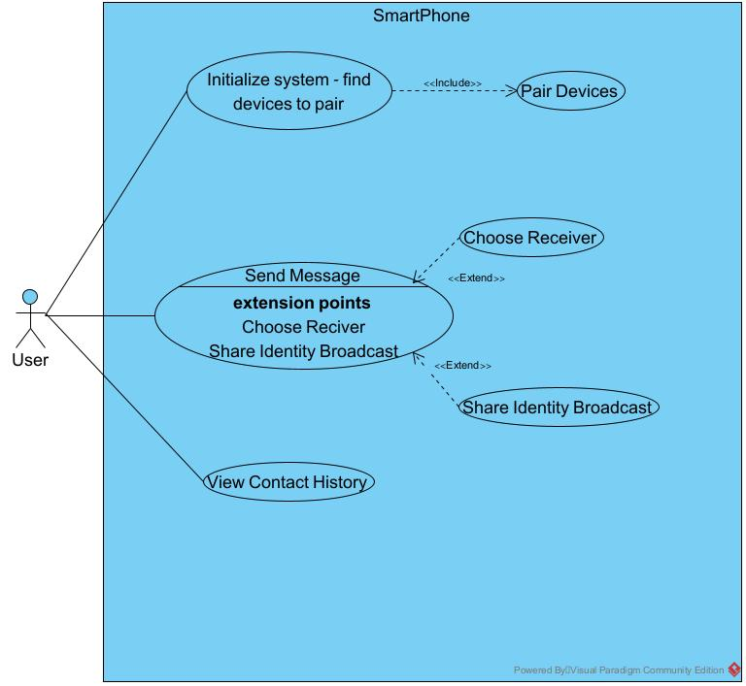
Use Case: Many-to-Many Interaction and Messaging Protocol

Slide 19
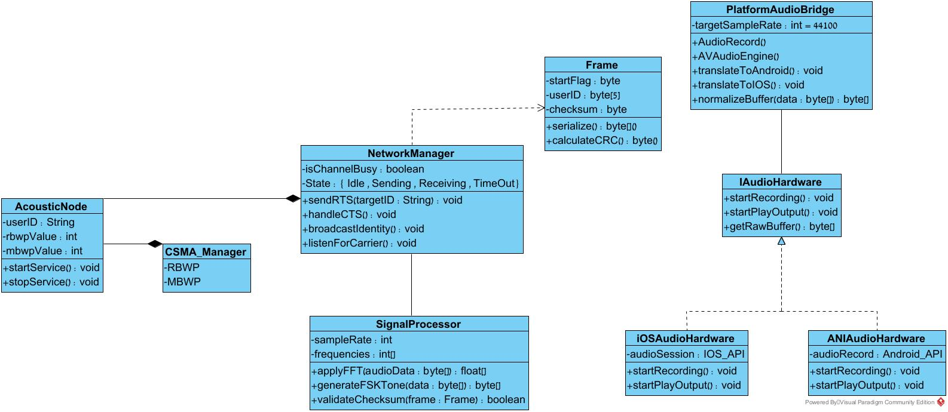
Class Diagram: Structural Design of the CSMA/CA and Signal Processing Layers

Slide 20
Comprehensive Testing of Embedded Communication:
This section presents the testing methodologies used to validate the functionality, integrity, and robustness of the embedded communication stack. It covers bit-level operations, physical layer characteristics, system integration, and real-world performance under various conditions.

Slide 21
Unit Testing: Bit Packing & Fragmentation Logic
Objective
1
Verify the ConstructPacket function accurately packs "Total Packets" and "Current Index" into a single byte.
Procedure
2
Input Total=3, Index=2. Execute the bit-packing logic.
Success Criteria
3
The resulting byte must be 0x32 (Binary 00110010).

Slide 22
Unit Testing: Checksum Calculation Accuracy
Objective
1
Validate the integrity of the CRC checksum algorithm used within the communication stack.
Procedure
2
Manually calculate the CRC sum for the string "TEST". Then, run the code's dedicated checksum function on the identical string.
Success Criteria
3
The output from the code's checksum function must precisely match the pre-calculated manual CRC sum.

Slide 23
Unit Testing: Packet Serialization
Objective
1
Ensuring the raw string payload is correctly transformed into the binary protocol frame according to strict ordering requirements.
Procedure
2
Pass the string "TEST" into the serializer function. Inspect the generated output bit array.
Success Criteria
3
The bit array must rigidly adhere to the defined frame structure: Preamble -> Sync -> Frag -> Length -> Payload -> Checksum.

Slide 24
Unit Testing: Frequency Analysis Algorithm
Objective
1
Test the FFT logic using a mathematically generated array to ensure precise frequency detection.
Procedure
2
Feed an array containing a pure mathematical sine wave of 18kHz into the detection function.
Success Criteria
3
The algorithm must return a significantly higher magnitude for the 18kHz bin when compared to the 20kHz bin.
Notes:
Testing the Fast Fourier Transform (FFT) logic for accurate frequency component detection using controlled input

Slide 25
Physical Layer Testing: Bit Duration and Timing
Objective
1
Confirm that each transmitted bit maintains an exact duration of 0.5ms, as specified by the protocol.
Procedure
2
Record the transmission of a single bit using an external PC equipped with audio editing software (e.g., Audacity). Measure the precise length of the recorded waveform.
Success Criteria
3
The measured waveform duration must be exactly 0.5ms, demonstrating accurate bit timing.

Slide 26
Integration Testing: Single Packet Transmission
Objective
1
Test the successful end-to-end transfer of a short message between devices.
Procedure
2
The transmitting (Tx) device sends the string "TEST" to the receiving (Rx) device.
Success Criteria
3
The Rx device correctly decodes the message, checksum validation passes, and the text "TEST" is displayed on the screen.

Slide 27
Integration Testing: RTS/CTS Handshake
Objective
1
Ensure the collision avoidance mechanism (Request To Send/Clear To Send) functions as expected.
Procedure
2
The Tx device initiates a transmission sequence.
Success Criteria
3
Tx waits for CTS. Rx sends CTS upon hearing RTS. Tx only transmits data after receiving CTS.

Slide 28
Field Testing: Maximum Effective Range
Objective
1
Determine the maximum reliable communication distance.
Procedure
2
Place devices 10cm apart; increase distance by 10cm until decoding fails.
Success Criteria
3
Document the precise distance at which reliable communication ceases.

Slide 29
Field Testing: Noise Immunity
Objective
1
Validate system performance in a noisy environment.
Procedure
2
Perform transmission while introducing external noise near the receiver.
Success Criteria
3
The system must successfully filter external noise and maintain communication integrity.

Slide 30
Field Testing: Wall/Barrier Penetration Test
Verifying the signal's ability to diffract around or penetrate obstacles, determining if direct Line-of-Sight (LOS) is mandatory for effective communication.
1
Step 1: Baseline
Establish a stable connection between devices at a distance of 2 metres.
2
Step 2: Level 1 Obstacle
Introduce a sheet of paper directly between the speaker and microphone.
3
Step 3: Level 2 Obstacle
Introduce a human body as an obstacle.
4
Step 4: Level 3 Obstacle
Introduce a solid wooden door or wall.
Success Criteria: Pass
The system must accurately report signal loss or checksum failure when the signal is blocked. It must not crash or display random garbage data.
Notes:
Verifying the signal's ability to diffract around or penetrate obstacles, determining if direct Line-of-Sight (LOS) is mandatory for effective communication.

Slide 31
Field Testing: Battery and Thermal Stability
Objective
1
Ensure the application does not crash or overheat during continuous operation.
Procedure
2
Run a continuous transmission loop for a minimum duration of 10 minutes.
Success Criteria
3
The application must remain stable throughout the test, with no "Application Not Responding" errors or unexpected terminations.
Notes:
Ensuring the application maintains operational integrity and optimal temperature during prolonged, continuous use

Slide 32

Thank You for Listening!

Slide 33
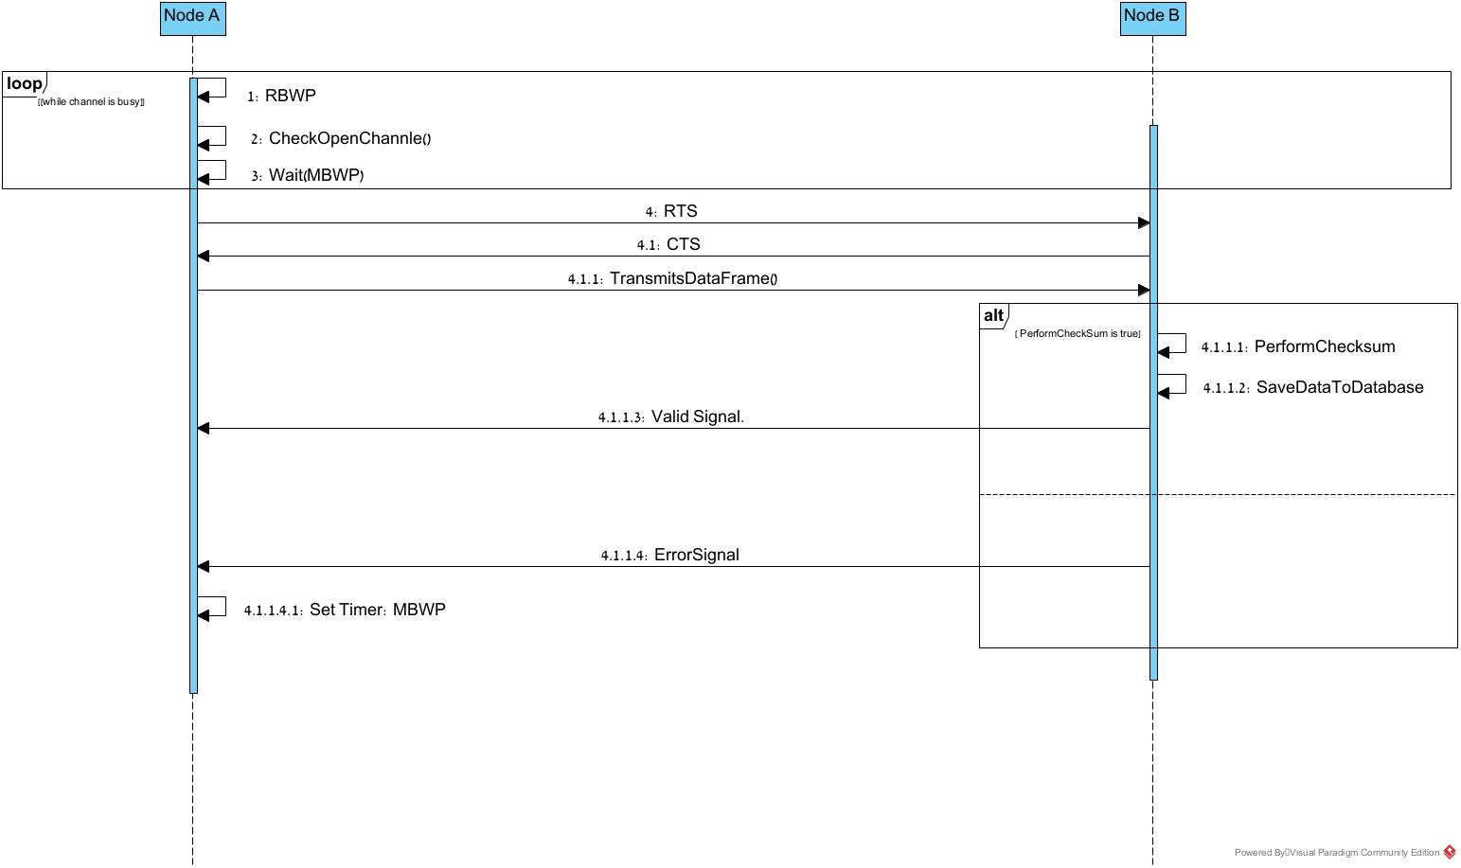
Sequence Diagram: CSMA/CA Protocol with RTS/CTS Handshake Sequence

Slide 34
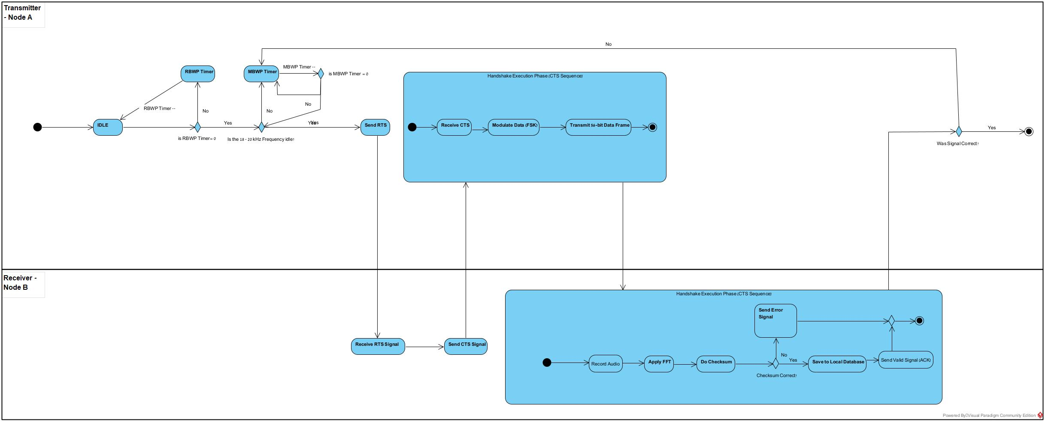
Activity Diagram: CSMA/CA Protocol with RTS/CTS Handshake

Slide 35
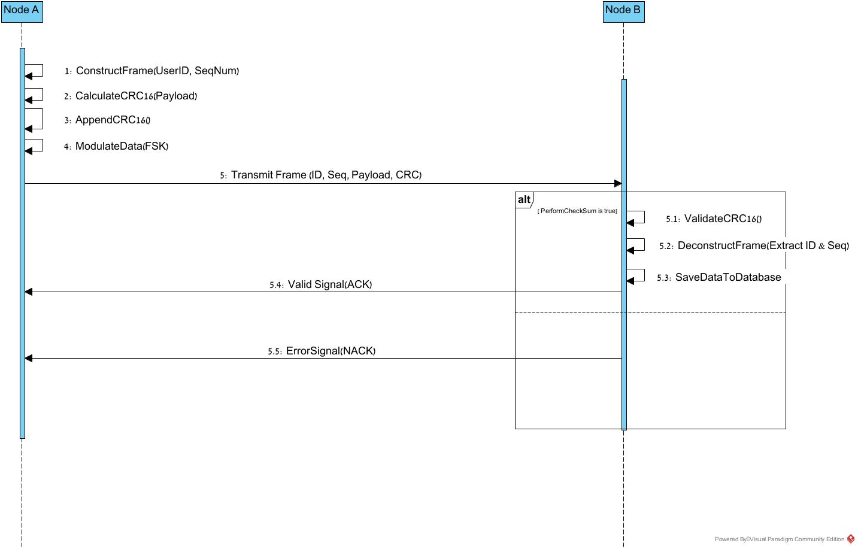
Sequence Diagram – Data Transmission and Frame Verification Protocol

Slide 36
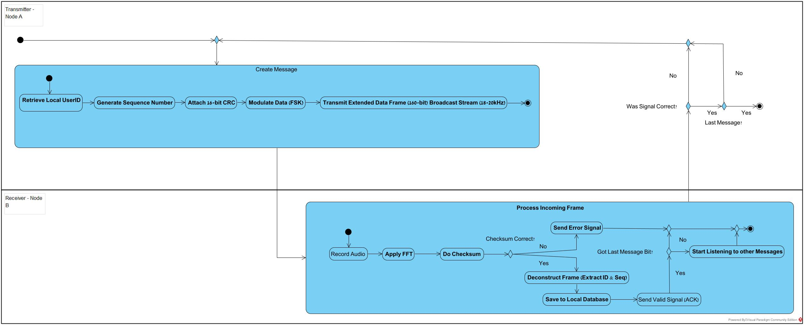
Activity Diagram: Data Framing and Physical Layer

